Slide 1
Why Summer Session at Duke?
More than 1,100 Duke undergraduates and 400 visiting students
Relaxed summer atmosphere
1 class in 4 weeks or 2 classes in 6 weeks
Highest quality academics
Great preparation for graduate school

Slide 2
Am I Eligible to Apply?
You are eligible to apply for admission to Duke Summer Session if you are currently, or have been, a college student in good standing at an accredited institution of higher learning.

Slide 3
Language Proficiency Scores
Minimum score of 100 TOEFL
Score of 7.0 for the IELTS
EIS test from The Graduate School

Slide 4
Dates
Term 1 2017
Traditional/6-week (May 16 – June 28)
Intensive/4-week (May 16 - June 9)
Term 2 2017
**Best Option for International Students**
Traditional/6-week (July 2 – August 12)
Intensive/4-week (July 10 – August 2)

Slide 5
Arriving on Campus*
Complimentary pick up service from Raleigh-Durham International Airport (RDU), the closest airport to campus.
Assistance checking in at your residence hall.
Welcome meeting/new student orientation with Summer Session staff.
Walking tour of campus (classrooms, libraries, dining facilities).
Assistance with obtaining Duke ID and signing up with Visa Services.
*Available during Term 2 only

Slide 6
Orientation*
Meet other students participating in the program.
Discover the rich variety of campus resources.
Receive information on exploring Durham and the local area.
Become familiar with classroom culture in the U.S.
Learn about all of the incredible programs available to you!
*Available during Term 2 only

Slide 7
Housing and Dining
Central Campus apartments are fully furnished except for cookware, eating utensils, TVs, and linens. Both one-bedroom apartments and two-bedroom suite apartments will be available.
Most Residence Halls on West Campus offer single and double rooms with community bathrooms. There are communal kitchens, common rooms, and study rooms available for student use.
Meal Plan or Flex (funds on deposit to use for dining facilities, merchants-on-points, and all Duke stores).
Note: housing & dining costs are in addition to tuition

Slide 8
FLEX
Flex is a pre-paid flexible spending account. Once you open an account, it is linked to your DukeCard.
It allows you to use your DukeCard to pay for textbooks, school supplies, laundry services, vending machines, food at campus eateries, and many other services on campus.

Slide 9
Things to Do on Campus
Nasher Museum of Art
Duke Campus Farm workdays
Duke University Chapel tours
Weekly farmers’ market
Sarah P. Duke Gardens
Duke Performances Series
American Dance Festival performances

Slide 10
Activities in the Area
“Music on the Lawn” at American Tobacco Campus in Durham.
“A Southern Summer” concerts at Southern Village in Chapel Hill.
Durham Bulls minor league baseball games.
“Pickin’ In the Plaza” concerts at Raleigh City Plaza in Raleigh.
Last Friday Art Walks in Hillsborough.

Slide 11
Duke Classes
Wide variety of disciplines offered
Two hours in class
3 – 6 hours independent study
Many seminar style classes
U.S. expectations of participation, opinion papers, projects, etc.

Slide 12
Workshops
International Student Orientation
Career Services
Graduate Admissions

Slide 13
Timeline
With agreement, submit student class choices early.
Open enrollment to Duke students February 19, 2018
Take EIS test early (cannot register for classes without this)
Final deadlines (apply early, most classes fill before these dates)
  Term 1: April 1, 2018
  Term 2: May 1, 2018

Slide 14
Feedback from Our Students
“It is really great and Duke actually cares for every International student.”
“People were kind and friendly.”
“The graduate workshop benefited me a lot.”
“The process of applying is simple and clear.”
“Stop thinking and just come!”
“Duke is an excellent university, and Durham is a lovely city!”

Slide 15
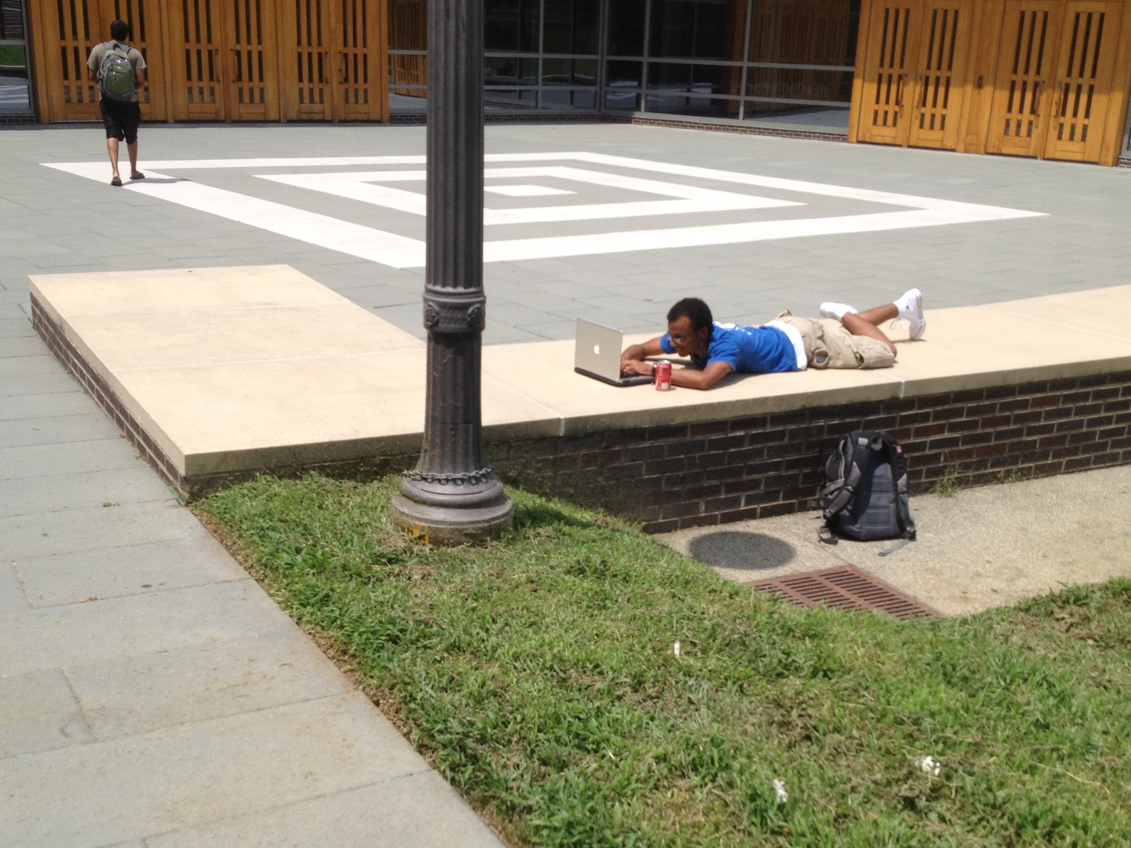
Contact
Kim Price
kprice@duke.edu
Nicki Charles
nicki.charles@duke.edu

